Slide 1
Bansal College of Engineering
BusEasy
Project Topic
Bus Ticket
Management System
SUBMITTED BY -
SUBMITTED TO -
Mohit Kumar Patel 0127CS211050
Chetan Doniwal 0127CS211024
Akshat Shukla 0127CS211008
Neelam Janyani 0127CS211053
Prof. Shikha Singh

Slide 2
BusEasy
A Bus Ticket Management System Web Application

Slide 3
Index
Objective​
Planning
Requirements Analysis
Technology Used
ER Diagram
Data Flow Diagram
Testing
Maintenance
Deployment
​Outcome
​Summary​

Slide 4
Objective
To streamline and automate the processes related to bus ticket booking and management for both passengers and bus operators.
The primary goals and objectives of system include:
Efficient Ticket Booking: Allow passengers to easily search for bus routes, view schedules, select seats, and book tickets online, reducing.
Seat Reservation: Provide the ability to reserve specific seats or choose seat preferences, ensuring passengers have control over their seating arrangements.
Ticket Availability: Display real-time information on ticket availability, helping passengers plan their trips in advance.

Slide 5
Planning

Slide 6
Requirement Analysis
1. User Management:
User registration and login for passengers and bus operators.
User profile management for updating personal information.
2. Bus Booking and Reservation:
Search and view bus routes, schedules, and availability.
Select seats, including seat preferences.
Book tickets for one-way or round trips.
Reserve specific seats.
View real-time ticket availability.
3. Payment Processing:
Support for various payment methods (credit/debit cards, mobile wallets, etc.).
Secure payment gateway integration.
Handling of payment failures and refunds.
4. Ticket Confirmation and Generation:
Email and SMS notifications upon successful booking.
Generation of electronic tickets (e-tickets) with QR codes or barcodes.
Option for printing physical tickets.
5. Ticket Modification and Cancellation:
Allow passengers to modify or cancel bookings within specified timeframes.
Implement refund policies and procedures.
6. Bus Operator Interface:
Dashboard for bus operators to manage schedules, availability, and seat assignments.
Ability to add, edit, or remove bus routes and trips.
Update bus details, including capacity and amenities.

Slide 7



Technology Used
Front-End
Back-End
Database
HTML5
CSS3
JavaScript
Node JS
Express JS
Mongoose
MongoDB

Slide 8
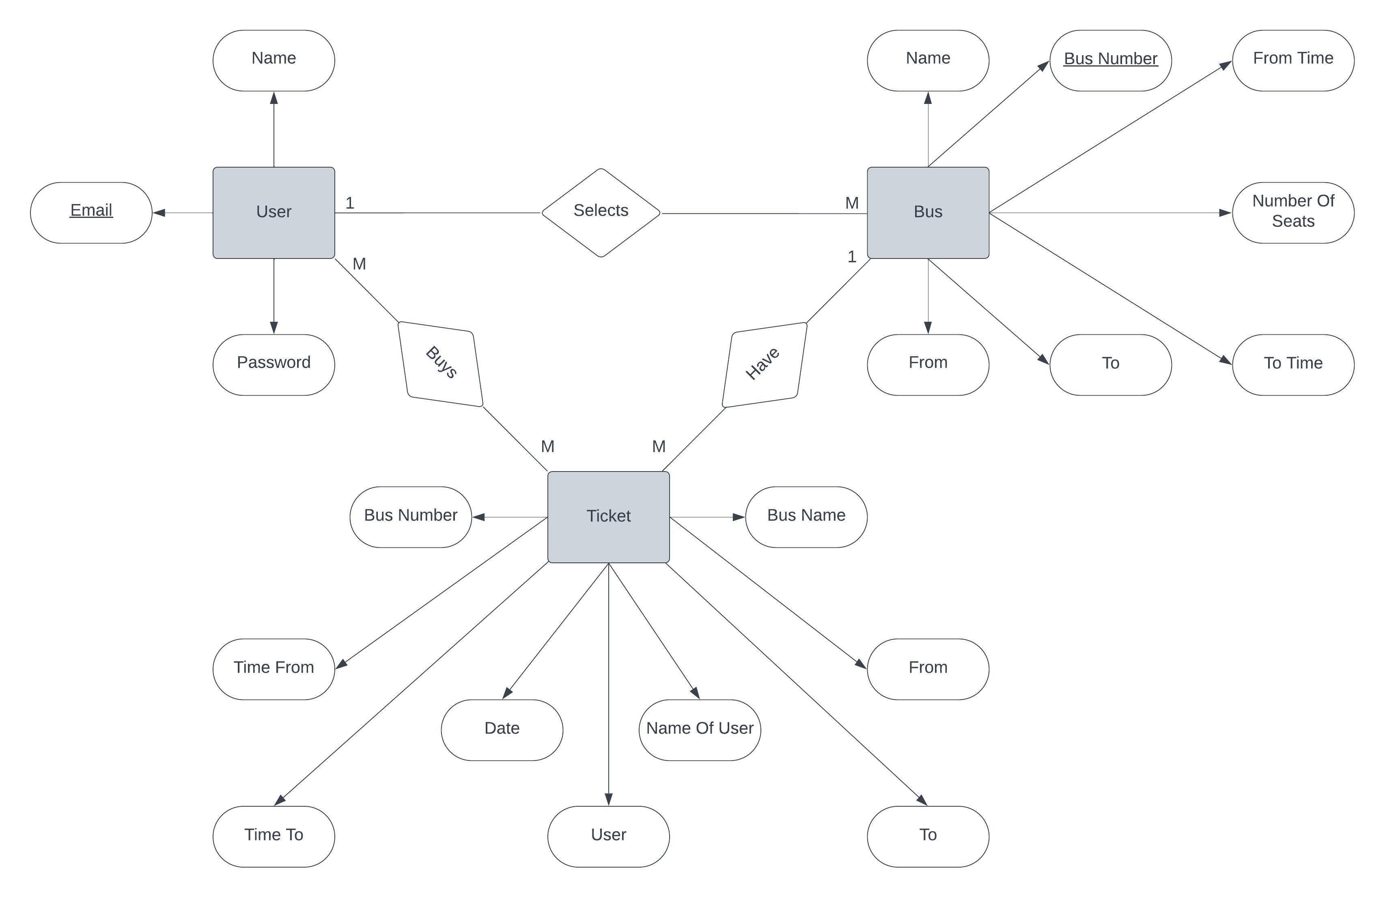
ER Model

Slide 9
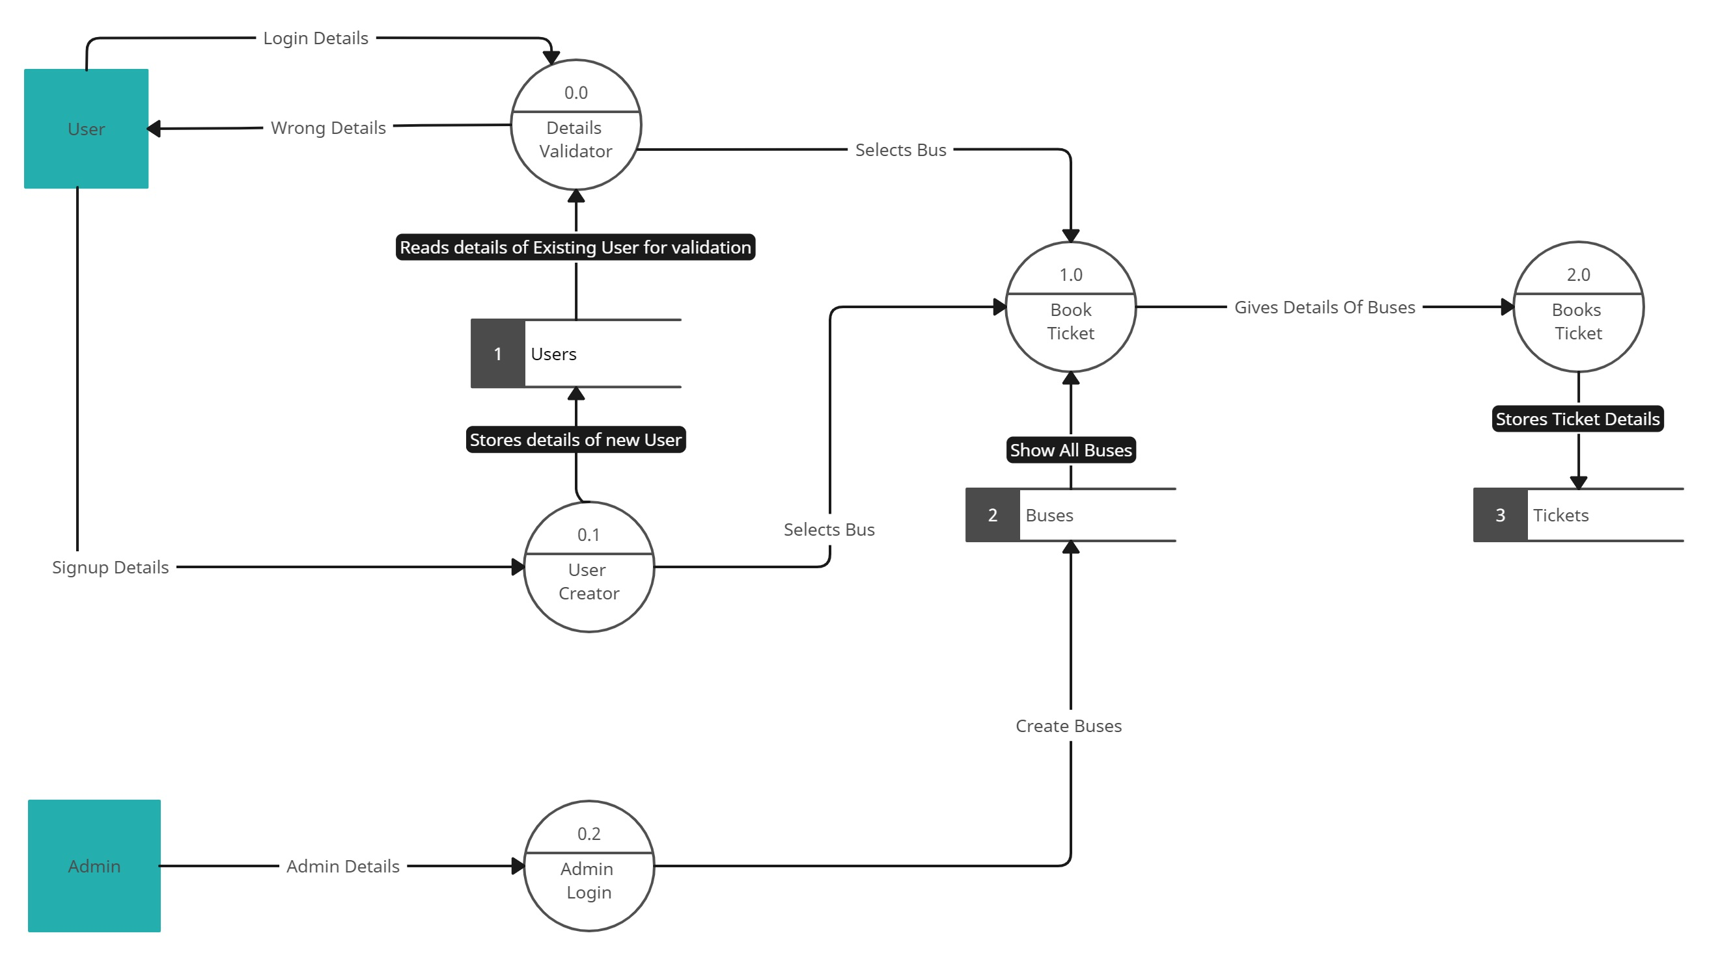
DATA FLOW DIAGRAM

Slide 10
Testing
Functional Testing: Ensure that all the application's functions work as intended, including:
User registration and login
Bus route search and selection
Seat reservation and booking
Payment processing
Ticket modification and cancellation
Admin and operator functionalities
Integration Testing: Test the integration points with third-party services, payment gateways, and APIs. - Ensure data synchronization and communication between different system components.
User Acceptance Testing (UAT):
Involve real users (passengers, administrators, and bus operators) to test the application in a real-world setting.
Ensure that users can perform tasks effectively and provide feedback on their experience.
Regression Testing: Continuously test previously working features after new changes or updates to ensure that updates have not introduced new issues.

Slide 11
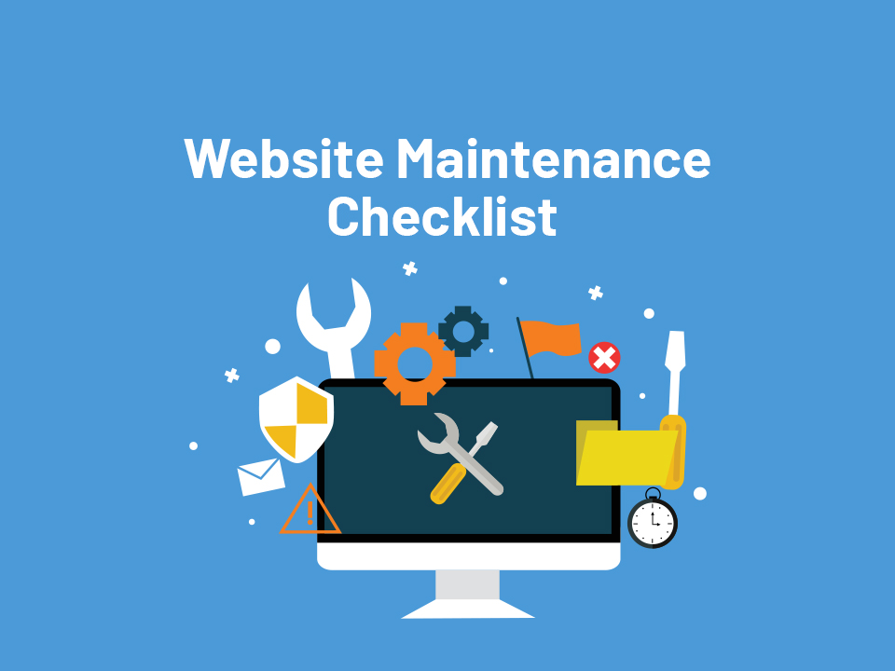
Maintenance
Regular Updates and Patching
Monitoring and Alerting
Database Maintenance
Security Audits and Vulnerability Scans
Content Management

Slide 12
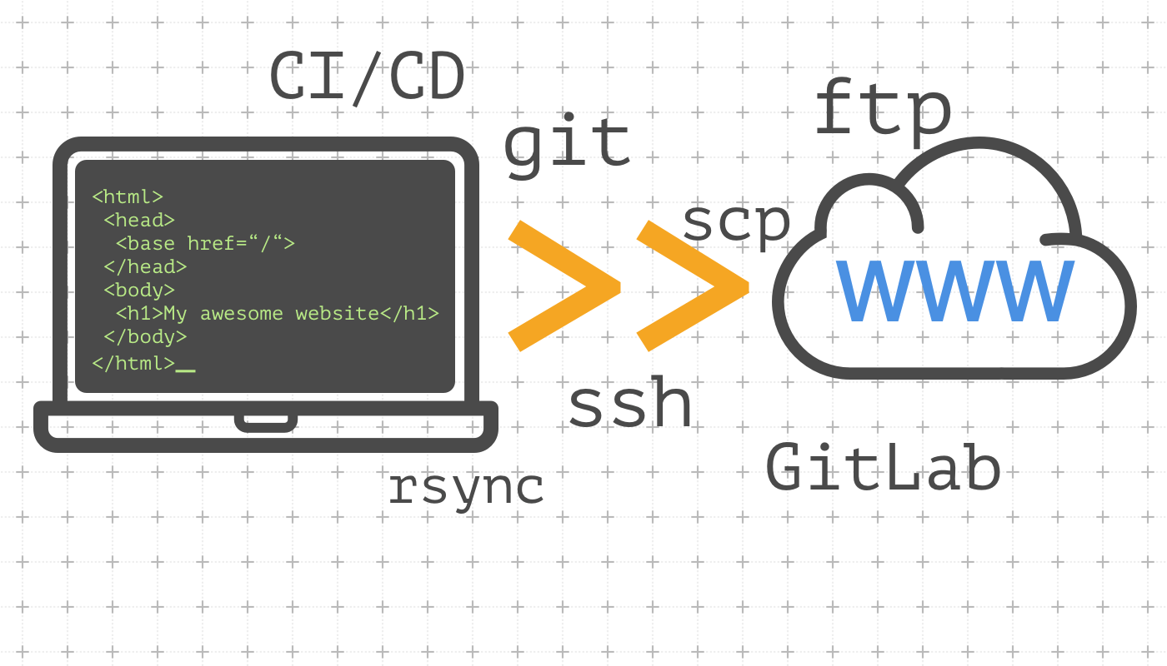
Deployment
Server Infrastructure Setup:
Choose a reliable hosting provider or cloud service based on your needs and budget.
Set up one or more virtual servers (VMs) with the necessary resources to host your web application.
Configure the server's operating system (usually Linux-based) and install required software components, including a web server, database server, and any other dependencies.
Domain Name and SSL Certificate:
Register a domain name and configure DNS settings to point to your server's IP address.
Secure your web application by installing an SSL certificate to enable HTTPS for secure data transmission.
Application Deployment:
Upload your application code and assets (HTML, CSS, JavaScript, images, etc.) to the server.
Set up a version control system (e.g., Git) on the server for easy code updates and rollbacks.
Database Setup:
Create the necessary databases and database users.
Import the initial database schema and seed data if required.

Slide 13
Outcome

Slide 14
The Outcome Of A Bus Ticket Management System Web Application Can Have Several Significant Benefits And Positive Impacts On Various Stakeholders, Including Passengers, Bus Operators, And Administrators.
For Passengers:
For Bus Operators:
Convenience
Seat Reservation
Online Payments
Flexibility
Ticket Confirmation
Feedback and Reviews
Efficiency
Resource Management
Data Insights
Cost Reduction
Scalability

Slide 15
summary
In summary, a bus ticket management system web application enhances the bus ticket booking process for passengers, streamlines operations for bus operators, and provides administrators with tools to monitor and manage the system effectively. It offers convenience, security, and efficiency in the bus transportation industry while promoting a user-friendly and sustainable ticketing experience.

Slide 16
THANK YOU
Mohit Kumar Patel
Muskan Patil
0127CS211050
0127CS211051
Naman Raghuwanshi
Neelam Janyani
0127CS211052
0127CS211053

